Slide 1
Chapter 5 – The vector space R^{n}

Slide 2
Our goal
Subspaces of R^{n}
Spanning sets
Independence
Bases of vector spaces
Dimensions
Length of a vector
Column space and row space of a matrix

Slide 3
n-Vectors
(x₁, x₂) // vector in R²
(x₁, x₂, x₃) // vector in R³
(x₁, x₂, x₃, x₄) // vector in R⁴
(x₁, x₂, …, x_{n}) // vector in R^{n}
A vector (x₁, x₂, …, x_{n}) in R^{n} is also called a point in R^{n}.
(0, 0, …, 0): the zero vector in R^{n}

Slide 4
Vector addition and scalar multiplication in R^{n}
u = u₁, u₂, …, u_{n})
v = (v₁, v₂, …, v_{n})
Vector addition:
u + v = (u₁ + v₁, u₂ + v₂, …, u_{n} + v_{n})
Scalar multiplication:
cv = (cv₁, cv₂, …, cv_{n})

Slide 5
examples
Given two vectors u = (2, -1, 1, 2), v = (3, 1, 2, -1)
Find u + v
u + v = (5, 0, 3, 1)
Find ½u
½u = (1, - ½, ½,1)
Find -3v
-3v = (-9, -3, -6, 3)
And find 3u - 2v
3u + 2v = (0, -5, -1, 8)

Slide 6
Write a vector as a linear combination of other vectors
Given u = (1, -1, 2), v = (2, 1, 3), w = (1, -3, 1).
Write w as a linear combination of u and v, that is find numbers a, b such that:
w = au + bv
(1, -3, 1) = a(1, -1, 2) + b(2, 1, 3)
= (a + b, -a + b, 2a + 3b)
w = 2u - v
a + b =1
-a + b = -3
2a + 3b = 1
➔ a = 2, b = -1
w
u
v

Slide 7
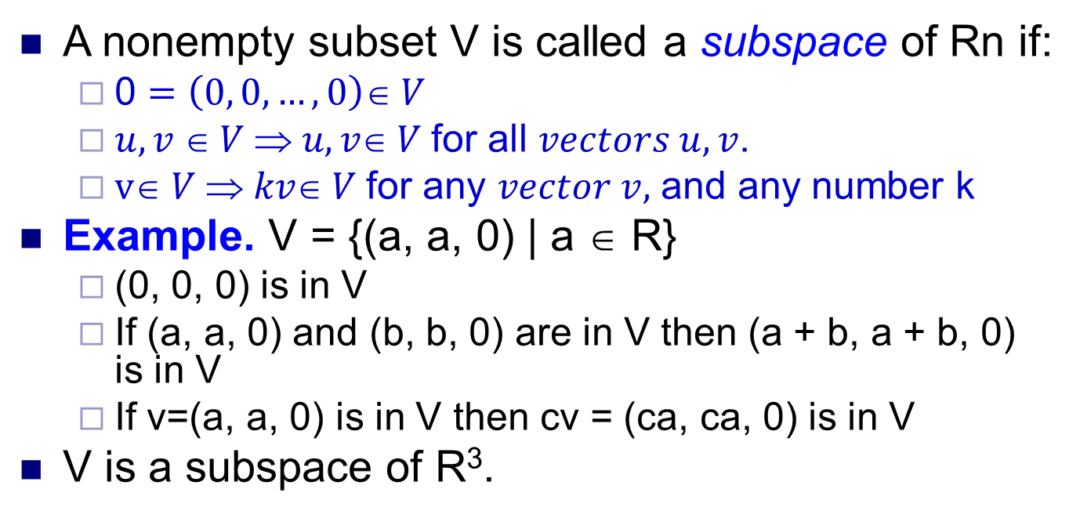
Definition - Subspaces of R^{n}
A nonempty subset V is called a subspace of Rn if:
0 $=\left(0, 0, …, 0\right)∈ V$
$u, v  V  u, v V$for all $vectors u, v$.
$v V  kv V$for any $vector v,$ and any number k
Example. V = {(a, a, 0) | a ∈ R}
(0, 0, 0) is in V
If (a, a, 0) and (b, b, 0) are in V then (a + b, a + b, 0) is in V
If v=(a, a, 0) is in V then cv = (ca, ca, 0) is in V
V is a subspace of R³.

Slide 8


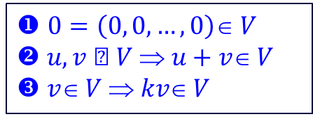
Some examples of sets that are NOT subspaces of R^{n}:
U=
V=
◆ $0=\left(0, 0, …, 0\right)∈ V$
$u, v  V  u+v V$ $v V  kv V$
W=

Slide 9
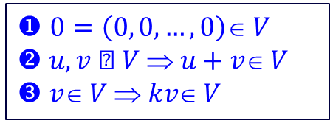
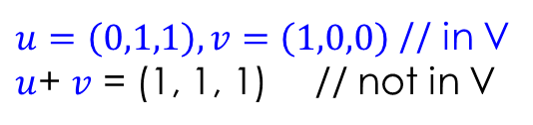
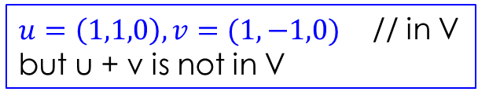

Some examples of sets that are NOT subspaces of R^{n}:
◆ $0=\left(0, 0, …, 0\right)∈ V$
$u, v  V  u+v V$ $v V  kv V$
$$u=\left(0,1,1\right), v=(1,0,0)$$
$u=\left(0,1,1\right), v=\left(1,0,0\right)$ // in V
$u$+ $v$ = (1, 1, 1) // not in V
V = {(a, b, c) | a = 0 or b = 0}
V = {(a, b, c) | a = b or a = -b}
$u=\left(1,1,0\right), v=(1,−1,0)$ // in V
but u + v is not in V

Slide 10
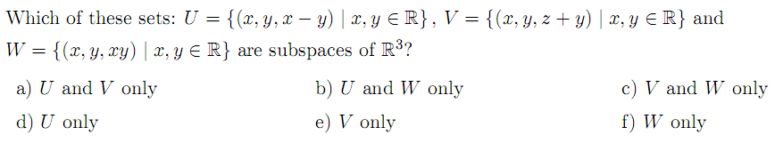
Subspace or not?
Key = a

Slide 11
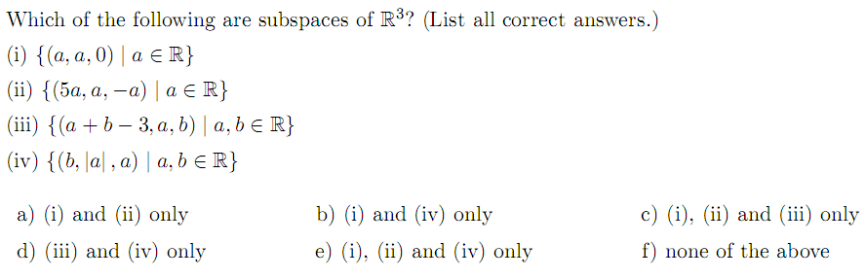
Subspace or not?
Key = a

Slide 12
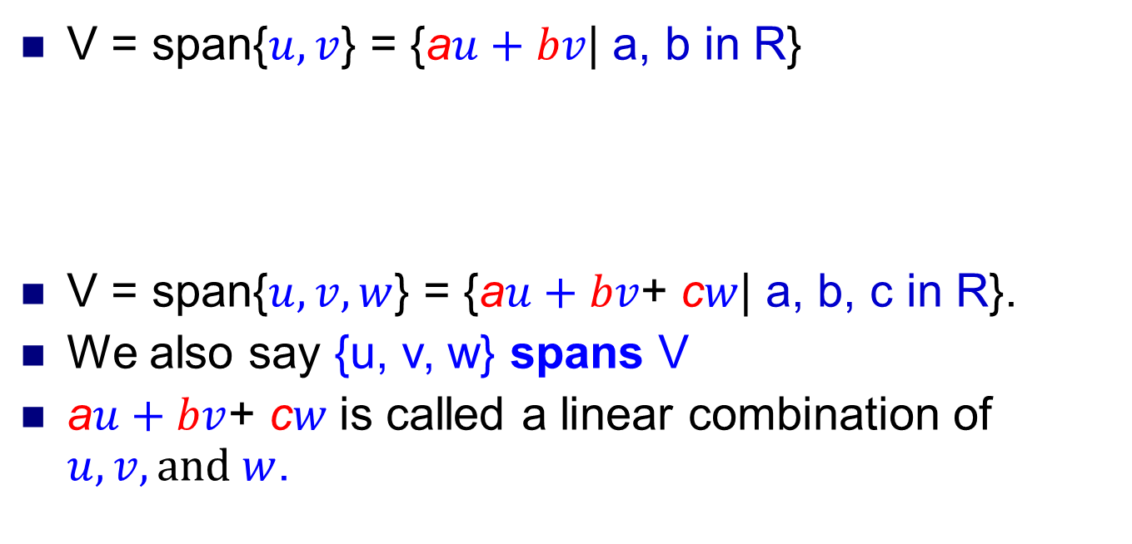
Spanning sets
V = span{$u, v$} = {a$u+bv$| a, b in R}
V = span{$u, v,w$} = {a$u+bv$+ c$w$| a, b, c in R}.
We also say {u, v, w} spans V
a$u+bv$+ c$w$is called a linear combination of $u, v,and w$.
u
v
V

Slide 13
Spanning sets - Examples
Given V = span{(-1, 2, 1), (3, -5, -1)}
(-1, 1, 1) ∈V?
Find m such that (-2, 1, m)∈V.
Solution.
a. (-1, 1, 1) = a(-1, 2, 1) + b(3, -5, -1)
(-1, 1, 1) = (-a + 3b, 2a – 5b, a –b)
b. (-2, 1, m) = a(-1, 2, 1) + b(3, -5, -1)
-a + 3b = -1
2a – 5b = 1
a – b = 1
-a + 3b = -2
2a – 5b = 1
a – b = m

Slide 14
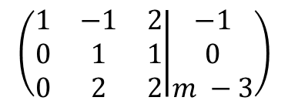
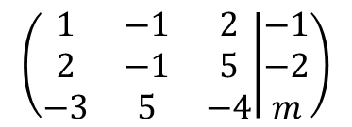
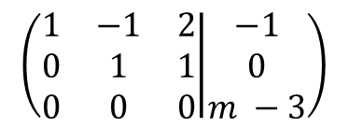
Spanning set - Example
Find m such that (-1, -2, m) lies in the subspace spanned by the vectors
(1, 2, -3), (-1, -1, 5) and (2, 5, -4).
Solution.
We want the system below has solution a, b, c:
(-1, -2, m) = a(1, 2, -3) + b(-1, -1, 5) + c(2, 5, -4)
(-1, -2, m) = (a -2b + 2c, 2a –b +5c, -3a + 5b -4c)
a – b + 2c = -1
2a – b + 5c = -2
-3a + 5b – 4c = m
$$\left(\begin{matrix}1 & −1 & 2 \\ 2 & −1 & 5 \\ −3 & 5 & −4\end{matrix} | \begin{matrix}−1 \\ −2 \\ m\end{matrix}\right)$$
$$\left(\begin{matrix}1 & −1 & 2 \\ 0 & 1 & 1 \\ 0 & 2 & 2\end{matrix} | \begin{matrix}−1 \\ 0 \\ m −3\end{matrix}\right)$$
$$\left(\begin{matrix}1 & −1 & 2 \\ 0 & 1 & 1 \\ 0 & 0 & 0\end{matrix} | \begin{matrix}−1 \\ 0 \\ m −3\end{matrix}\right)$$
m = 3

Slide 15
linear combination
Given u = (1, -1, 2), v = (-2, 0, 3) and w = (-3, 2, 1)
Write x = (1, 0, 2) as a linear combination of u, v, and w.
We find numbers a, b, c such that:
x = au + bv + cw
(1, 0, 2) = a(1, -1, 2) + b(-2, 0, 3) + c(3, 2, 1)
(1, 0, 2) = (a -2b + 3c, -a + 2c, 2a + 3b + c)
1a -2b + 3c = 1
-1a + 0b + 2c = 0
2a + 3b + 1c = 2
a = 2, b = -1, c = 1
➔ x = 2u –v + w

Slide 16
Spanning sets – Do yourself
Find the values of t for which (2, -1, t) lies in the subspace spanned by the vectors (-1, 1, 0) and (2, -3, -1).
For what values of x does the vector (1, 1, x) is a linear combination of the vectors (1, 0, -3) and (-2, 1, 5)?
Find the values of m such that (4, -2, -1, m) lies in the subspace spanned by the vectors (1, 0, -1, 1), (1, 0, 0, 1), and (2, -1, 1, 0).

Slide 17
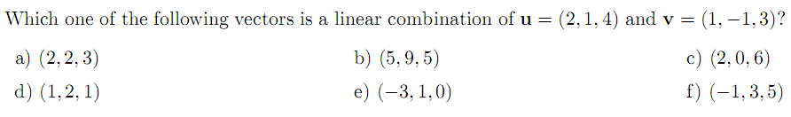
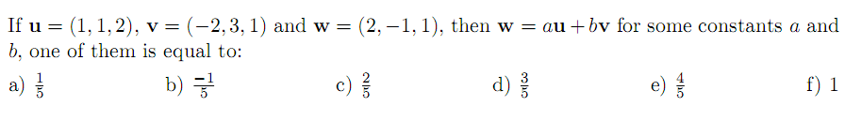
Spanning sets. Linear combinations.
Key = d, e, b
Let X = (-1, -3, 3) and U = span{Y = (1, 0, 3), Z = (1, 1, 1)}. If X is in U, write X =aY + bZ, then find the sum a+b.
X is not in U b) a+b = -1
c) a+b = 4 d) a+b = 0 e) None of these

Slide 18
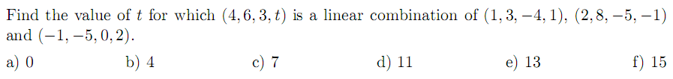
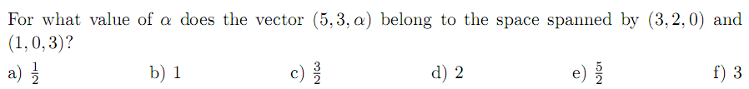
Spanning sets. Linear combinations.
Key = e, c, a
Suppose V = span{(1, -1, 0), (2, -1, 1), (-1, 0, 1)}. Find all values of t
such that (1, 2, t)∈ V.
a) t is arbitrary b) t = 3/2 c) t = 3 d) t = -1

Slide 19
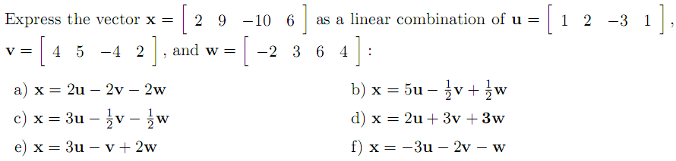
Spanning sets. Linear combinations.

Slide 20
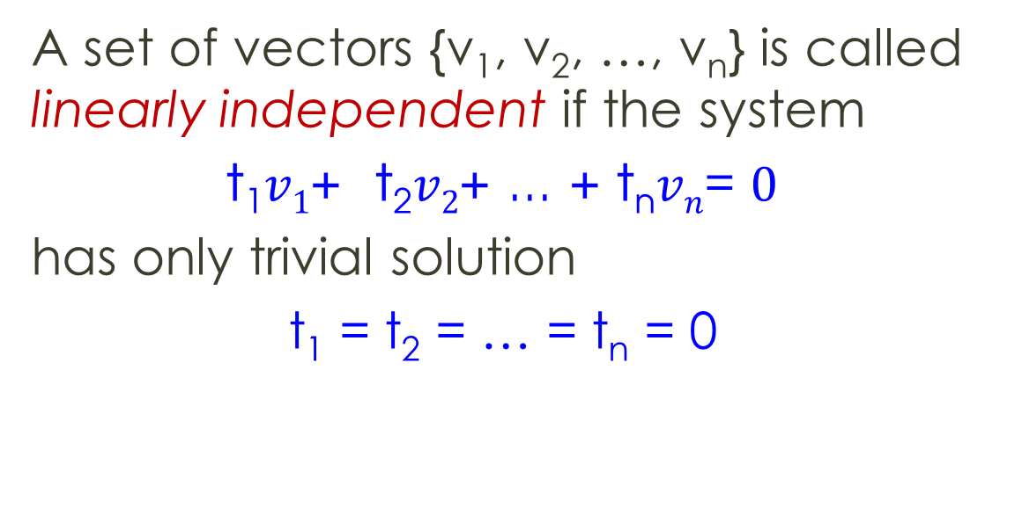
Linear independence
A set of vectors {v₁, v₂, …, v_{n}} is called linearly independent if the system
t₁$v1$+ t₂$v2$+ ... + t_{n}$vn$= $0$
has only trivial solution
t₁ = t₂ = … = t_{n} = 0

Slide 21

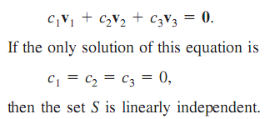

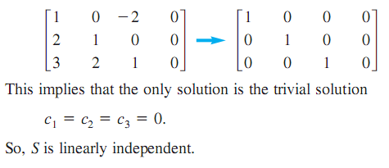

Linearly independent
⇔
Number of leading ones
= number of vectors

Slide 22
Do yourself

Slide 23
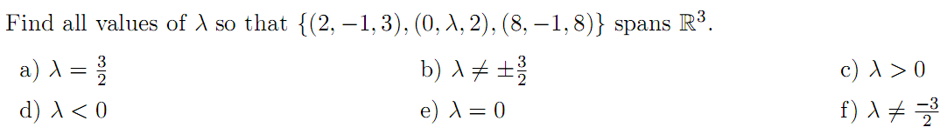
Basis of a vector space
A basis = A spanning set that is linearly independent.
If B is a basis of a vector space V, then:
In R^{n}, n a set of n vectors is a basis of R^{n} if and only if it is linearly independent.
B spans V
B is linear independent

Slide 24
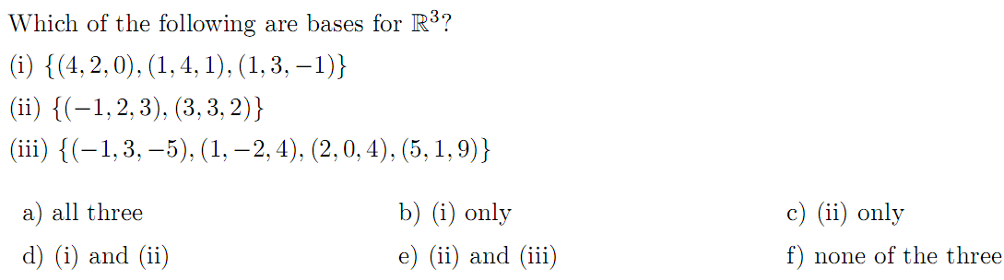
Choose a set of 3 vectors
And this set must be linearly independent

Slide 25

Dimensions
Dimension = number of vectors in a basis
dim(R^{n}) = n
If U ⊆ V then dim(U) ≤ dim(V)
dim(subspace) ≤ 3 = dim(R³)
Dimension is not 4 or more than 4
Dim( ) = 2 = number of leading ones
1
2
-1
1 -3 2
-2 2 0
1 -1 0
1
0
0
1 -3 2
-4 8 -4
2 -4 2
1
0
0
1 -3 2
1 -2 1
0 0 0

Slide 26


Slide 27
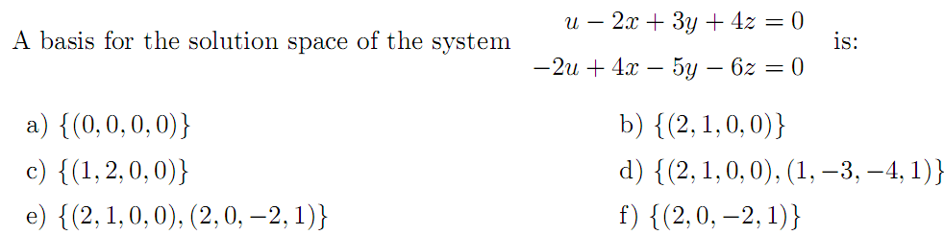
Solution space
dim(solution space) = n – r // n: number of variables,
r = number of leading ones

Slide 28
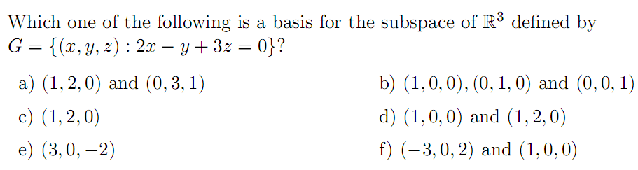
Dim(G) = n – r = 3 – 1 = 2 ➔ a basis for G contains 2 vectors
c, e, b impossible
In other hand, (1, 0, 0) is not in G ➔ can not be d, f
➔ a

Slide 29
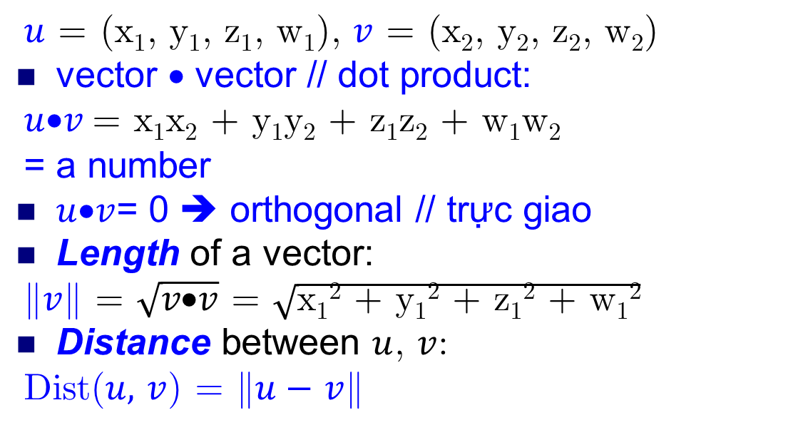
Dot product
$u$ = (x₁, y₁, z₁, w₁), $v$ = (x₂, y₂, z₂, w₂)
vector • vector // dot product:
$u$•$v$= x₁x₂ + y₁y₂ + z₁z₂ + w₁w₂
= a number
$u$•$v$= 0 ➔ orthogonal // trực giao
Length of a vector:
$v$ = $\sqrt{v\text{•}v}$ = $\sqrt{\text{x}\text{1}\text{2}\text{ +} \text{y}\text{1}\text{2}\text{ + }\text{z}\text{1}\text{2}\text{ + }\text{w}\text{1}\text{2}}$
Distance between $u$, $v$:
Dist($u,$ $v$) = $u−$ $v$

Slide 30
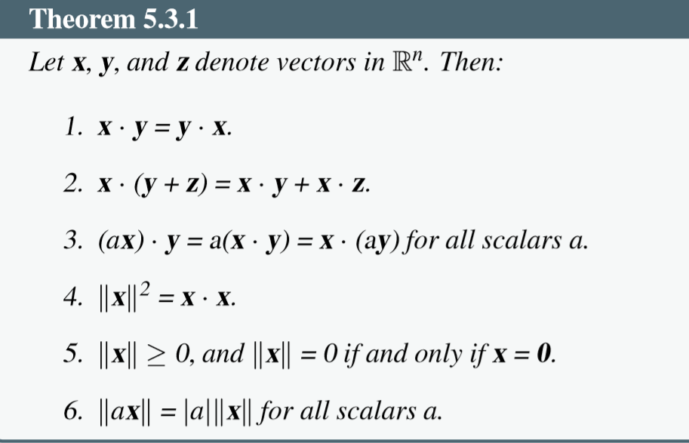
Properties

Slide 31
Row space, column space and Rank of a matrix
A is a mxn matrix
rank(A) ≤ m, rank(A) ≤ n
Row space of a matrix
Row(A) = span{row1, row2, …, rowm}
(rows = vectors)
Column space of a matrix
Col(A) = span{col1, col2, …, coln}
dim(row(A)) = dim(col(A)) = rank(A)

Slide 32
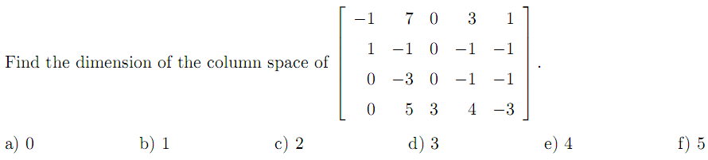
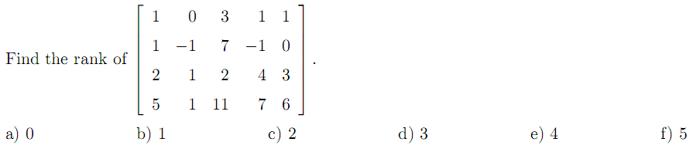
Dim(col(A)) = rank(A)

Slide 33
Solution space
dim(solution space) = n – r // n: number of variables,
r = number of leading ones

Slide 34
Solution space: Dim(G) = n – r = 2

Slide 35
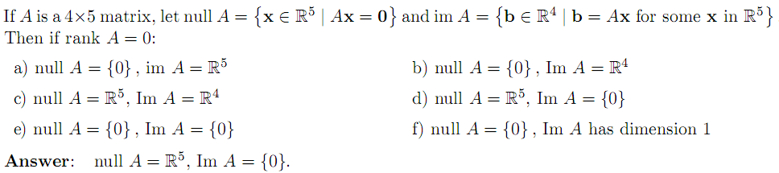

Null space and image space of a mxn matrix A
Null space of a matrix A:
Null(A) = {$\vec{X}$:A$\vec{X}$ = $\vec{0}\}$
(solution space of a homogeneous system)
dim(null(A)) = n – r
Image space:
Im(A) = {all image AX: X in R^{n}} = col(A)
dim(im(A)) = dim(col(A)) = rank(A)

Slide 36
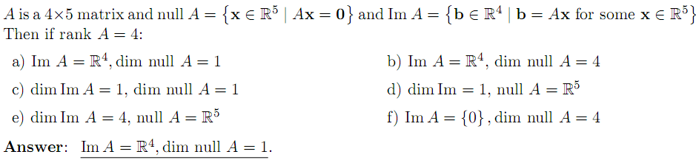

Slide 37
THANKS

